Slide 1
Angular Training
Angular Directive
Chee Guan, Ang
Angular Pipe
October 8 2020

Slide 2
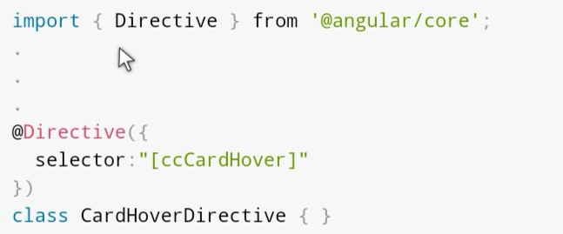
Angular Directive
Overview
Directives are components without a view/template
@Component decorator is actually a @Directive decorator extended with template-oriented features.
basically a class with a @Directive decorator.
typically associate directives to existing elements by use attribute selectors
<element aDirective></element>
Directive can be classified into two types: structural and attribute directives.

Slide 3
Angular Directive
Attribute Directive
listen to and modify the behavior of other HTML elements, attributes, properties, and components
specify what change you want to occur and what CSS event (if any) you want to trigger that change
Most common Angular built-in Attributes Directives:
NgClass - adds and removes a set of CSS classes.
NgStyle - adds and removes a set of HTML styles.
NgModel - adds two-way data binding to an HTML form element

Slide 4

Angular Directive
Attribute Directive
HostListener - @HostListener
is a function decorator that accepts an event name as an argument. When that event gets fired on the host element it calls the associated function.
HostBinding - @HostBinding
bind input properties in the host element

Slide 5
Angular Directive
Attribute Directive
DEMO

Slide 6
Angular Directive
Structural Directive
responsible for shape or reshape the DOM’s structure by adding, removing, or manipulating elements
An asterisk (*) precedes the directive attribute name
does not require brackets or parentheses like attribute directive
Usually user structural directive with microsyntax
Most common Angular built-in Structural Directives:
NgFor
NgIf
NgSwitch

Slide 7
Angular Directive
Structural Directive - Microsyntax
Angular microsyntax lets you configure a directive in a compact, friendly string.
Microsyntax parser translates that string into attributes on the <ng-template>
Microsyntax in Angular allows you to write <div *ngFor="let item of items">{{item}}</div> instead of <ng-template ngFor [ngForOf]="items"><div>{{item}}</div></ng-template> .
*:prefix="( :let | :expression ) (';' | ',')? ( :let | :as | :keyExp )*"
:prefix: HTML attribute key.
:key: HTML attribute key.
:local: local variable name used in the template.
:export: value exported by the directive under a given name.
:experession: standard angular expression
:keyExp = :key ":"? :expression ("as" :local)? ";"?
:let = "let" :local "=" :export ";"?
:as = :export "as" :local ";"?

Slide 8
Angular Directive
Structural Directive - Microsyntax
Example
With Microsyntax | Without Microsyntax
*ngFor="let item of [1,2,3]“ | <ng-template ngFor let-item [ngForOf]="[1,2,3]">
*ngFor="let item of [1,2,3] as items; trackBy: myTrack; index as i" | <ng-template ngFor let-item [ngForOf]="[1,2,3]" let-items="ngForOf" [ngForTrackBy]="myTrack" let-i="index">
*ngIf="exp" | <ng-template [ngIf]="exp">
*ngIf="exp as value" | <ng-template [ngIf]="exp" let-value="ngIf">

Slide 9

Angular Directive
Structural Directive
To change DOM(Document Object Model) layout we should use TemplateRef and ViewContainerRef in structural directive
TemplateRef : represents an embedded template that can be used to instantiate embedded views.
ViewContainerRef : represents a container where one or more views can be attached

Slide 10
Angular Directive
Angular Structural Directive
DEMO

Slide 11
Angular Directive
Q&A?

